Slide 1

Region 5 Sales Report
Sainsbury’s
December 14, 2021
Tarun Malarmaran
Notes:
1

Slide 2

Agenda
Introduction
Insights from Customer & Locations
Sales Performance
Customer Behaviour
Summary
Conclusion
Notes:
2

Slide 3

Introduction
The data available is between the period April, 2016 and March, 2018. Which is complete annual sales data for the 2016/17 and 2017/18 financial years for the South East Region 5.
The goal to generate insights from the data to visualise the sales performance and customer behaviour.

Slide 4

Insights from Store Locations and NECTAR Sectors
Customers & Locations

Slide 5
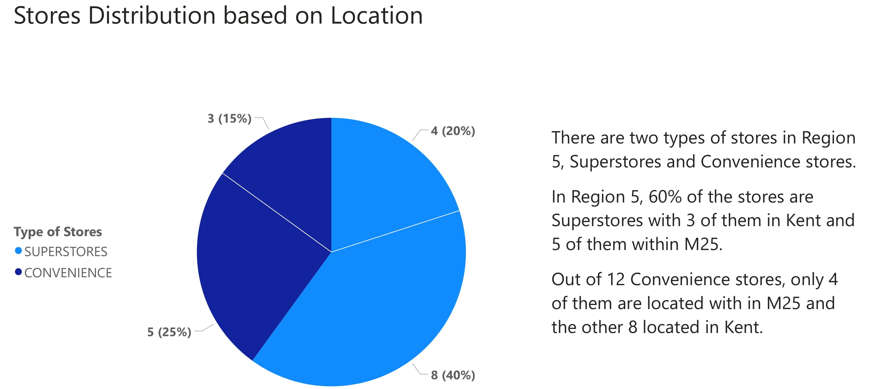
Summary of Store Locations

Slide 6
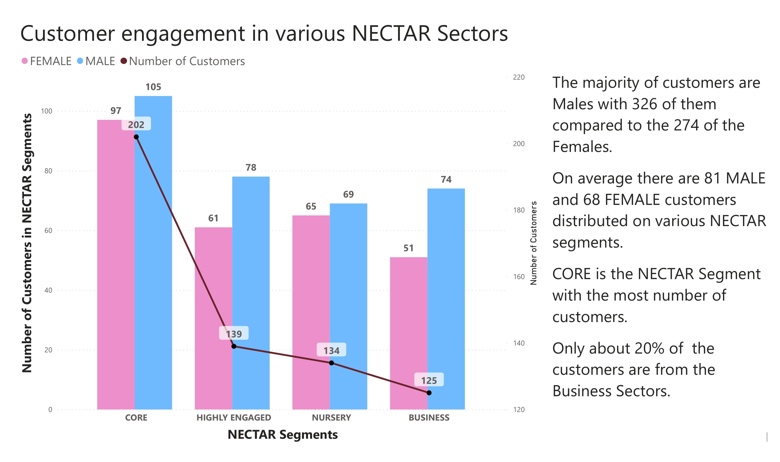
Customers across NECTAR sectors

Slide 7
Sales Performance
Sainsbury’s Region 5

Slide 8
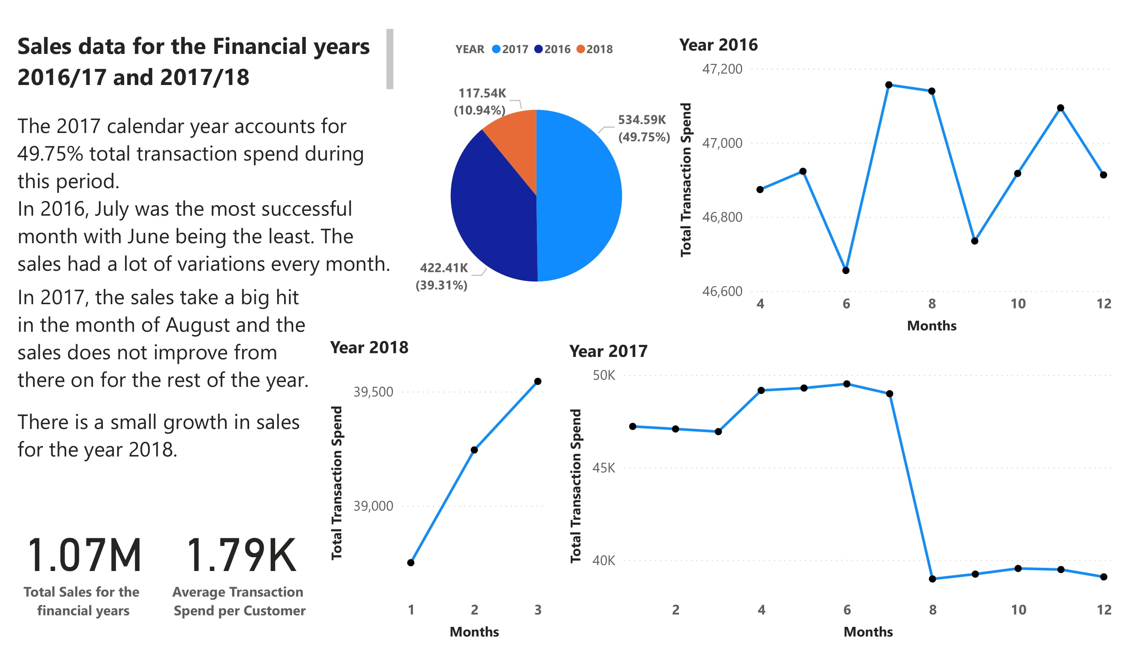

Slide 9

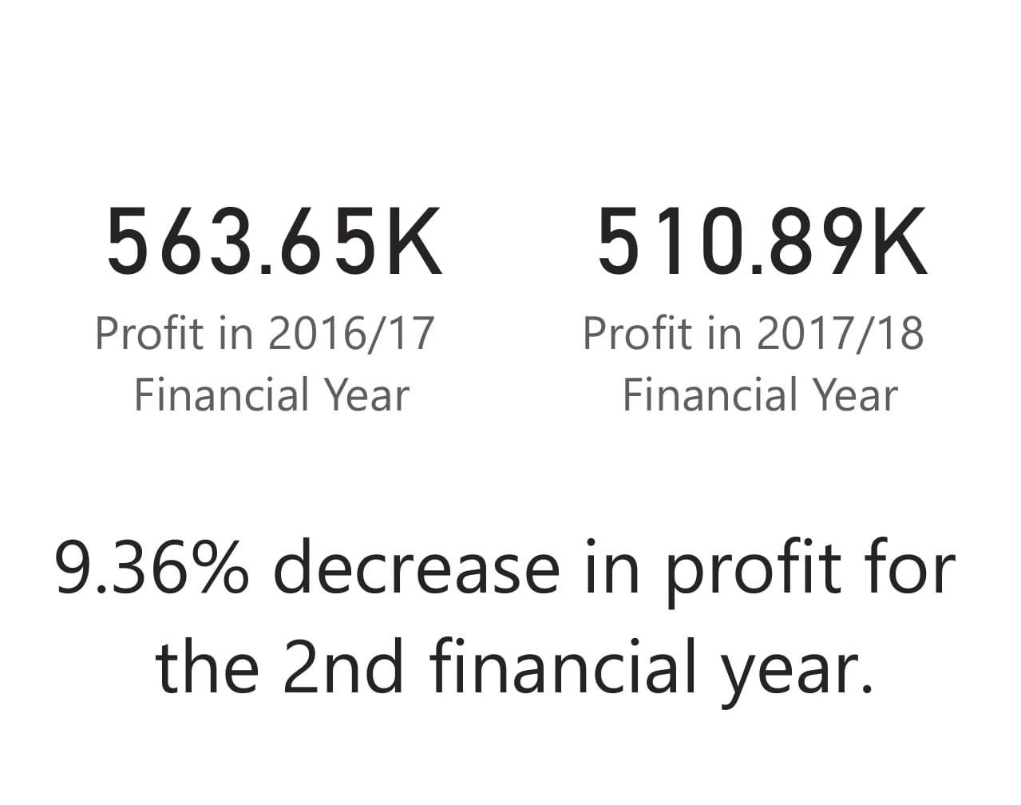
Sales Summary

Slide 10
Customer Behaviour
Sainsbury’s Region 5

Slide 11
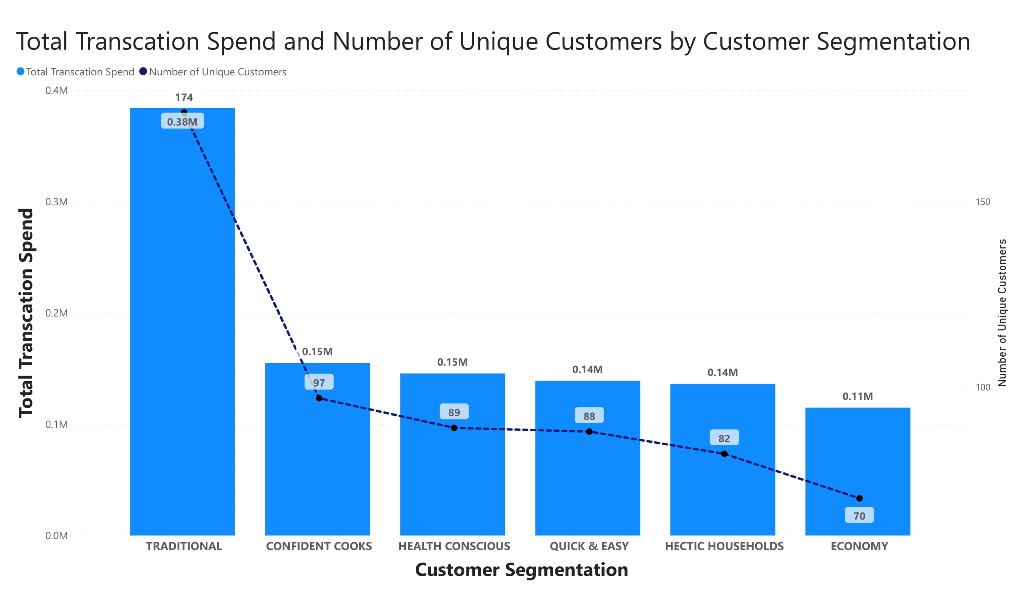

Slide 12
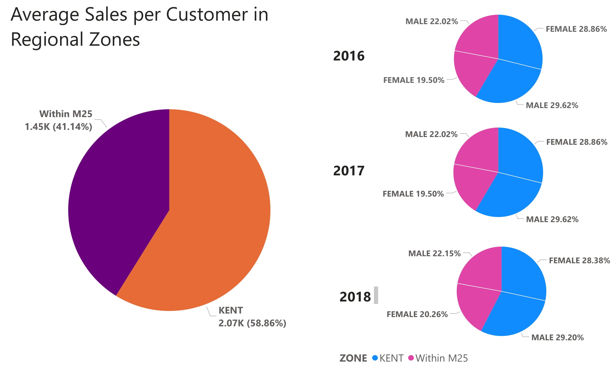
Sales Summary

Slide 13

There was a 9.36% decrease in sales for the financial 2017-18 compared to the previous year with a sales of over 563k generated.
Sainsbury’s Region 5

Slide 14

Summary
Sales opportunities
Business priorities
The sales in the festive period decreased from year 2016 to 2017.
For the stores within M25, customers can be targeted based on the popular Sainsbury’s sector and offering special discounts.
There is opportunity in Traditional customers, segment specific offer can be targeted.
Increase the customer base in Region 5.
Customer attraction in the stores within M25.

Slide 15

Conclusion
The Sainsbury’s Customers are much engaged in the Core Nectar sector, the way to increase the sales in Region 5 can be by offering discounts for the customers under the sector.
The sales towards the end of 2017 calendar year was underwhelming, but there are promising improvement in the first few months of 2018.
Tarun Malarmaran
Tarun.malarmaran@gmail.com

